Slide 1

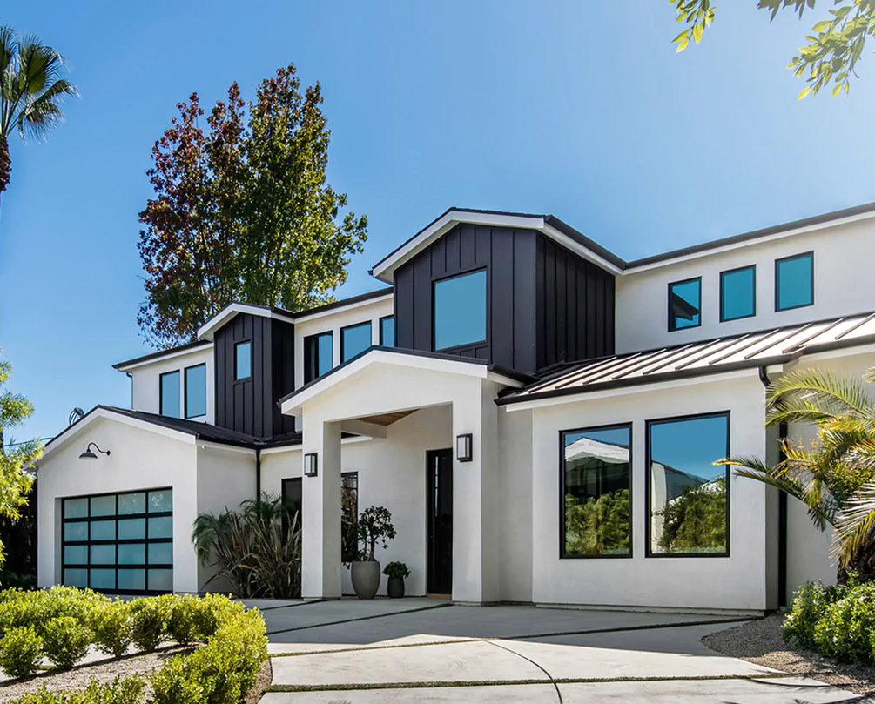
California Housing Price Prediction
Melody Yang
Capstone project

Slide 2
Overview
Business Problem
Data Source & Exploratory Data Analysis
Model Selection
Summary
Limitation

Slide 3
Business Problem
Real estate investors, local sellers, and buyers want to find out the factors that impact the housing price in California.
Goal: Identify the factors that impact housing price

Slide 4
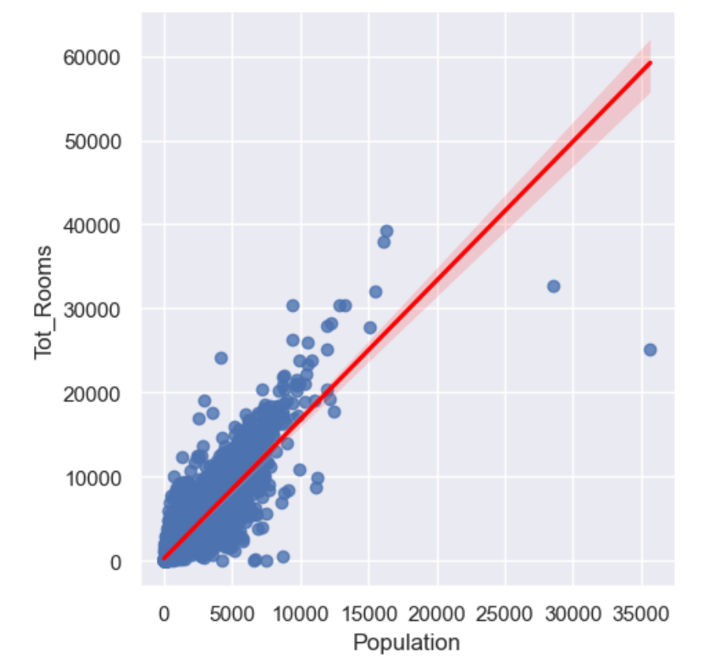
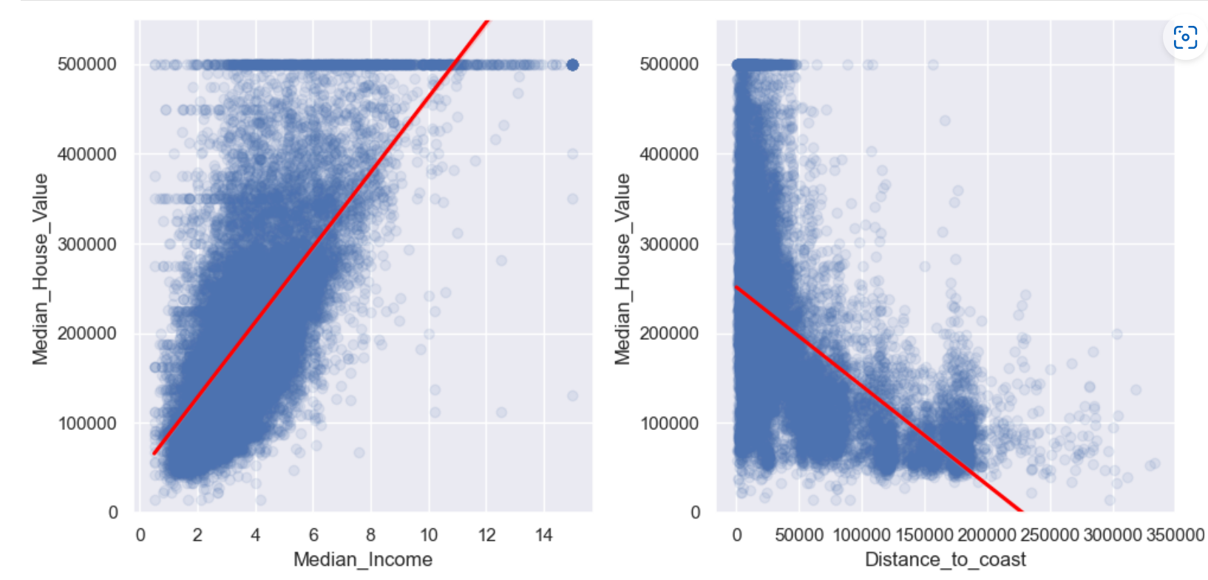
Data source / EDA – 1/2
Data Source: California Housing Prices Data from Kaggle
EDA summary
The top ten house value is $50001 and their ages are around late 40’s and 50’s
There is correlation for median house value and median income, it’s very clearly to see upward trend. distance to coast and house value has downward trend
Population and bedroom has very strong positive relationship

Slide 5
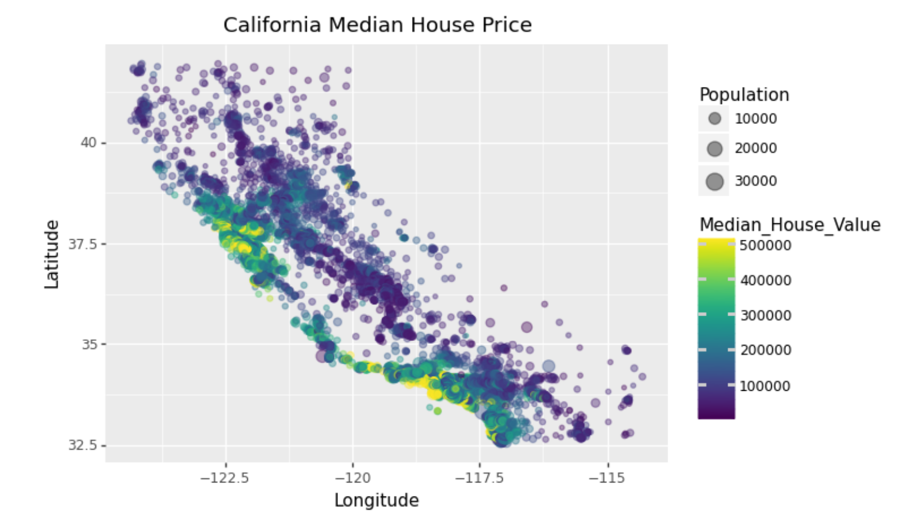
EDA Summary 2/2
4. From the graph, It is very clearly to see the house price incases as it more close to the coast especially in LA, San Diego (Southern California), San Francisco, and Bay area (Northern California)

Slide 6
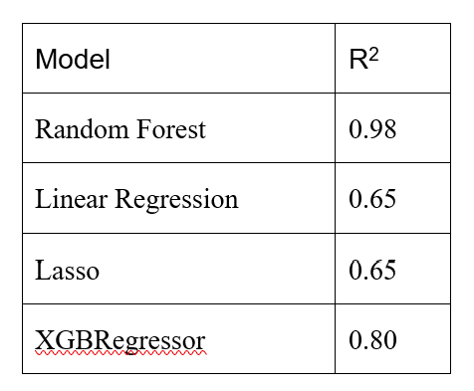
Model Selection
Tested 4 different models
Evaluated models using R² values
Best Model: Random Forest

Slide 7
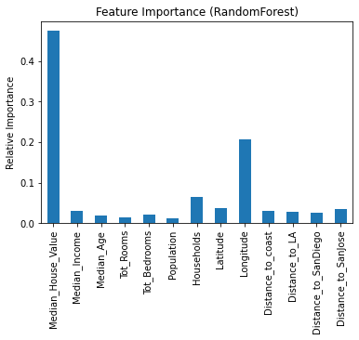
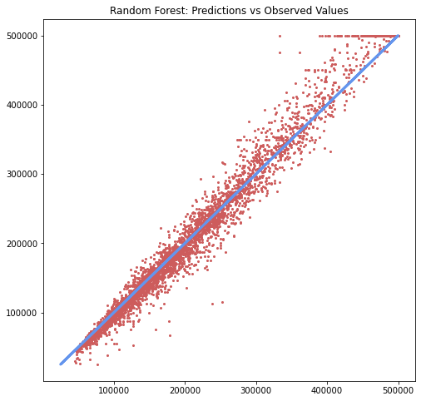
Summary
Location is the key factor in this dataset as Longitude, Distance to San Jose, and Distance to coast are the highest ones under the location variables
Next factor that impacts the price is the household and follow by the income.
The Random forest model also fits well for the housing value.

Slide 8
Limitation
The dataset was from 1990 census data, so the model built here may not be able to predict the trend of the current housing price.
It may be better to include more variables (features) in the dataset, which allows us to consider better other variables that impact housing prices in the real life

